Slide 1


Data Analyst Specialists Track
Data-Driven Strategies for optimizing
E-commerce Sales Performance
Digital Egypt Pioneers Initiative (DEPI)
Supervised by: Eng. Jackie Abu Aleem

Slide 2


Prepared By
Abdelrahman Hassan Mahmoud
Amany Alaraby
Mahmoud Mohammed Shoshan
Maysan Salah Elghanam

Slide 3

Introduction
This data outlines A solution for tracking and analyzing the marketing and sales performance of e-commerce platform using A combination of excel, Python, SQL, and power BI.
The primary goal is to provide real-time insights into the effectiveness of marketing campaigns and sales activities, enabling data-driven decision-making.
By implementing this solution, we will gain better visibility into key performance indicators (kpis). These insights will lead to optimized marketing spend, improved customer targeting, and increased revenue.

Slide 4
Roles & Responsibilities
THE PROJECT WAS CARRIED OUT BY A TEAM OF FOUR MEMBERS, WITH TASKS
DIVIDED TO LEVERAGE EACH INDIVIDUAL’S STRENGTHS AND ENSURE EFFICIENT COMPLETION OF THE OBJECTIVES :
SQL and Python Development: Abdelrahman Hassan and Mahmoud Shoshan. Abdelrahman and Mahmoud were responsible for all SQL and Python tasks. They worked together on data management, database querying, and implementing necessary Python scripts to support the project’s data needs.
Power BI and Documentation: Maysan Salah and Amany Alaraby Maysan and Amany handled the data visualization and reporting aspects of the project using Power BI. Together, they also worked on creating comprehensive documentation to capture the project’s progress, findings, and deliverables.

Slide 5
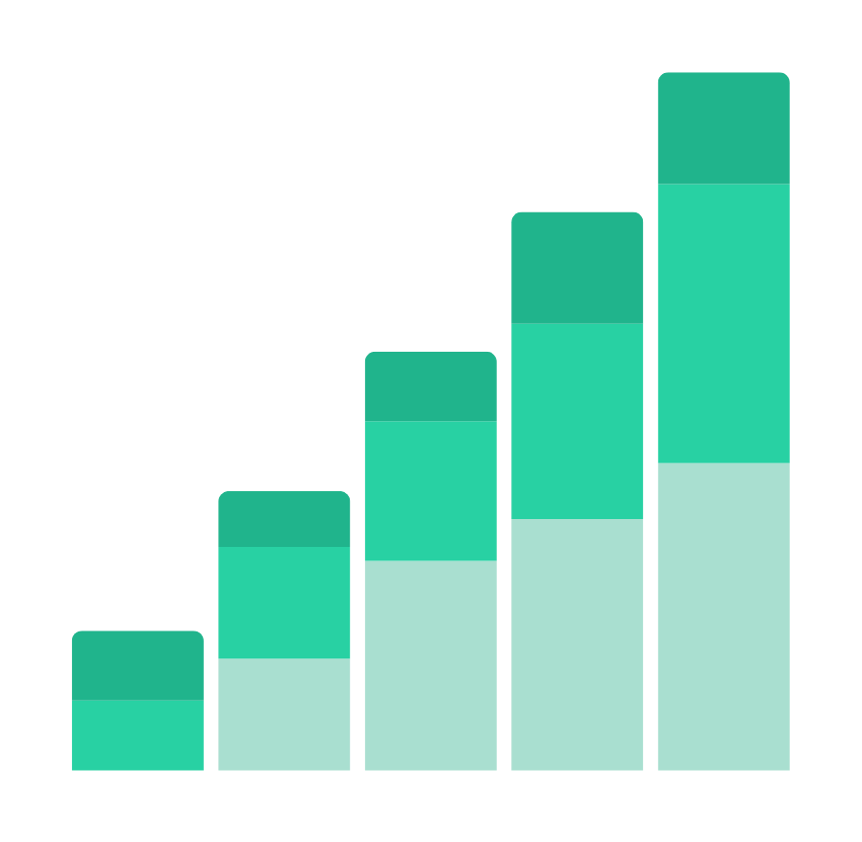
Goals and Objectives
Consolidate data from various sources into A single SQL database for easy access and analysis.
Build automated dashboards using power bi to track real-time marketing and sales performance.
Analyze key metrics.
Use data insights to identify high-performing marketing campaign and reduce wasted spend.
Create forecasting models to predict future sales and marketing outcomes.

Slide 6

Proposed Solution
01.
Excel: For initial data cleaning, basic analysis, and manual reports.
02.
SQL: For consolidating, storing, and querying large datasets from different sources
03.
Python : for data handling and cleaning and EDA
04.
Power BI: For creating interactive dashboards and visualizations that provide real-time insights into key marketing and sales metrics.

Slide 7
Methodology
Step 1.
Step 2.
Step 3.
Step 4.
Connect SQL to Power BI: Import data from the SQL database into Power BI.
Create Dashboards: Develop interactive dashboards that track KPIs in real time.
Drill-Down Capabilities: Allow users to drill down into specifics for more detailed insights.
Sales Forecasting: Use historical sales data to create forecasting models in Python, which can then be integrated into Power BI for real-time updates.
Marketing Optimization: Based on the insights from the dashboards, provide recommendations on which marketing channels to focus on, which campaigns to optimize, and where to cut costs.
Extract Data: Collect data from Kaggle platforms
Data Cleaning: Use SQL and Excel to clean and preprocess the data
Standardize Data: Standardize different data formats
SQL Queries: Write SQL queries to aggregate and calculate key metrics
Trend Analysis: Use SQL and Python to identify trends in sales and marketing performance over time.

Slide 8
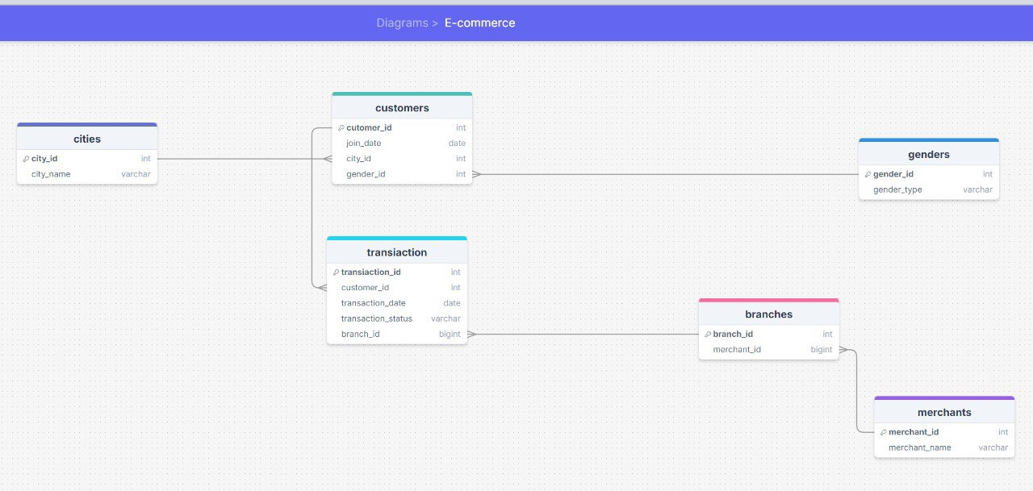
Dataset Contents
Cities – Stores city information.
Genders – Stores gender types.
Merchants – Stores merchant details.
Customers – Stores customer information, linked to cities and genders.
Branches – Stores merchant branch locations.
Transactions – Records customer transactions, including transaction status and burn dates.
Relational database: In order to understand the relationship between our tables we created schema using drawsql.app

Slide 9
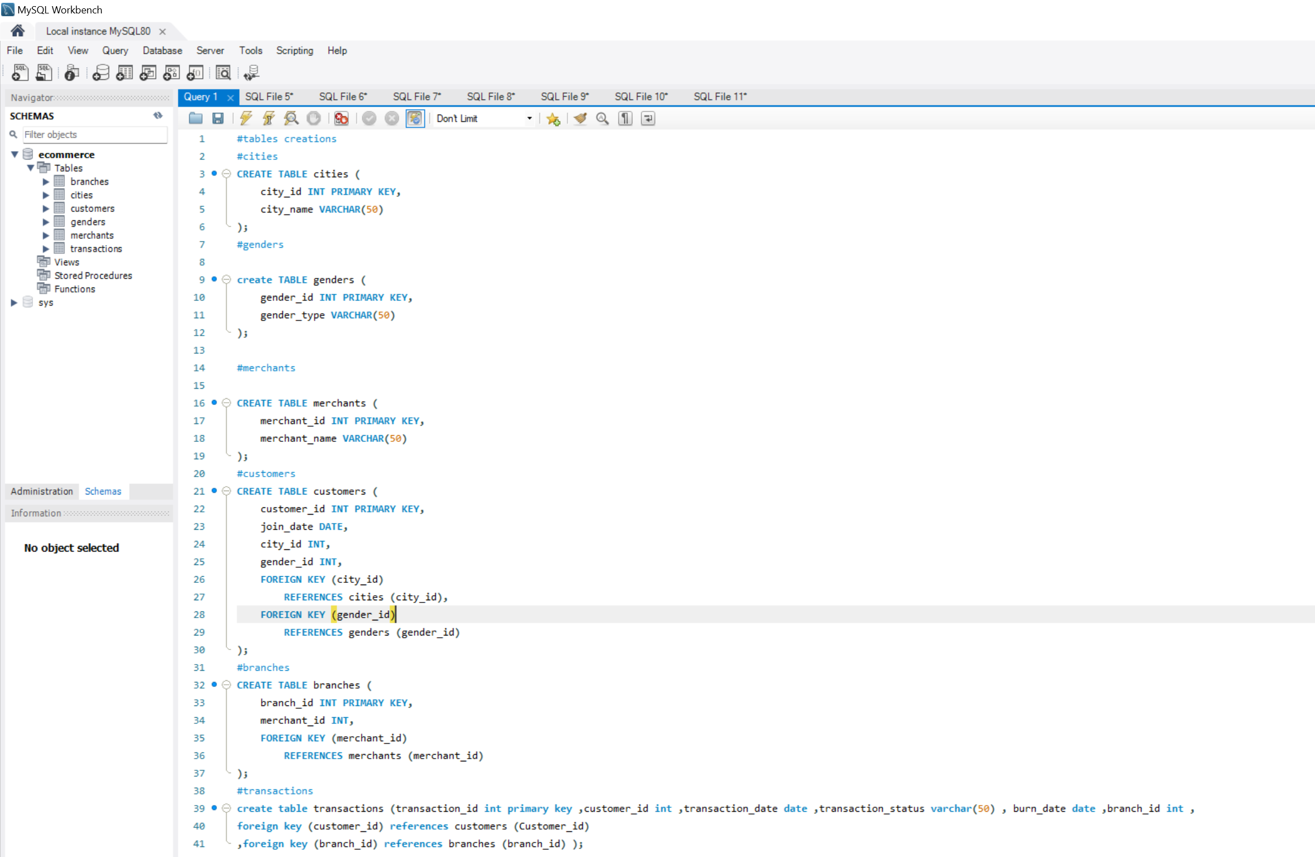
Table creation
we used SQL SERVER to make the tables using the following queries:

Slide 10

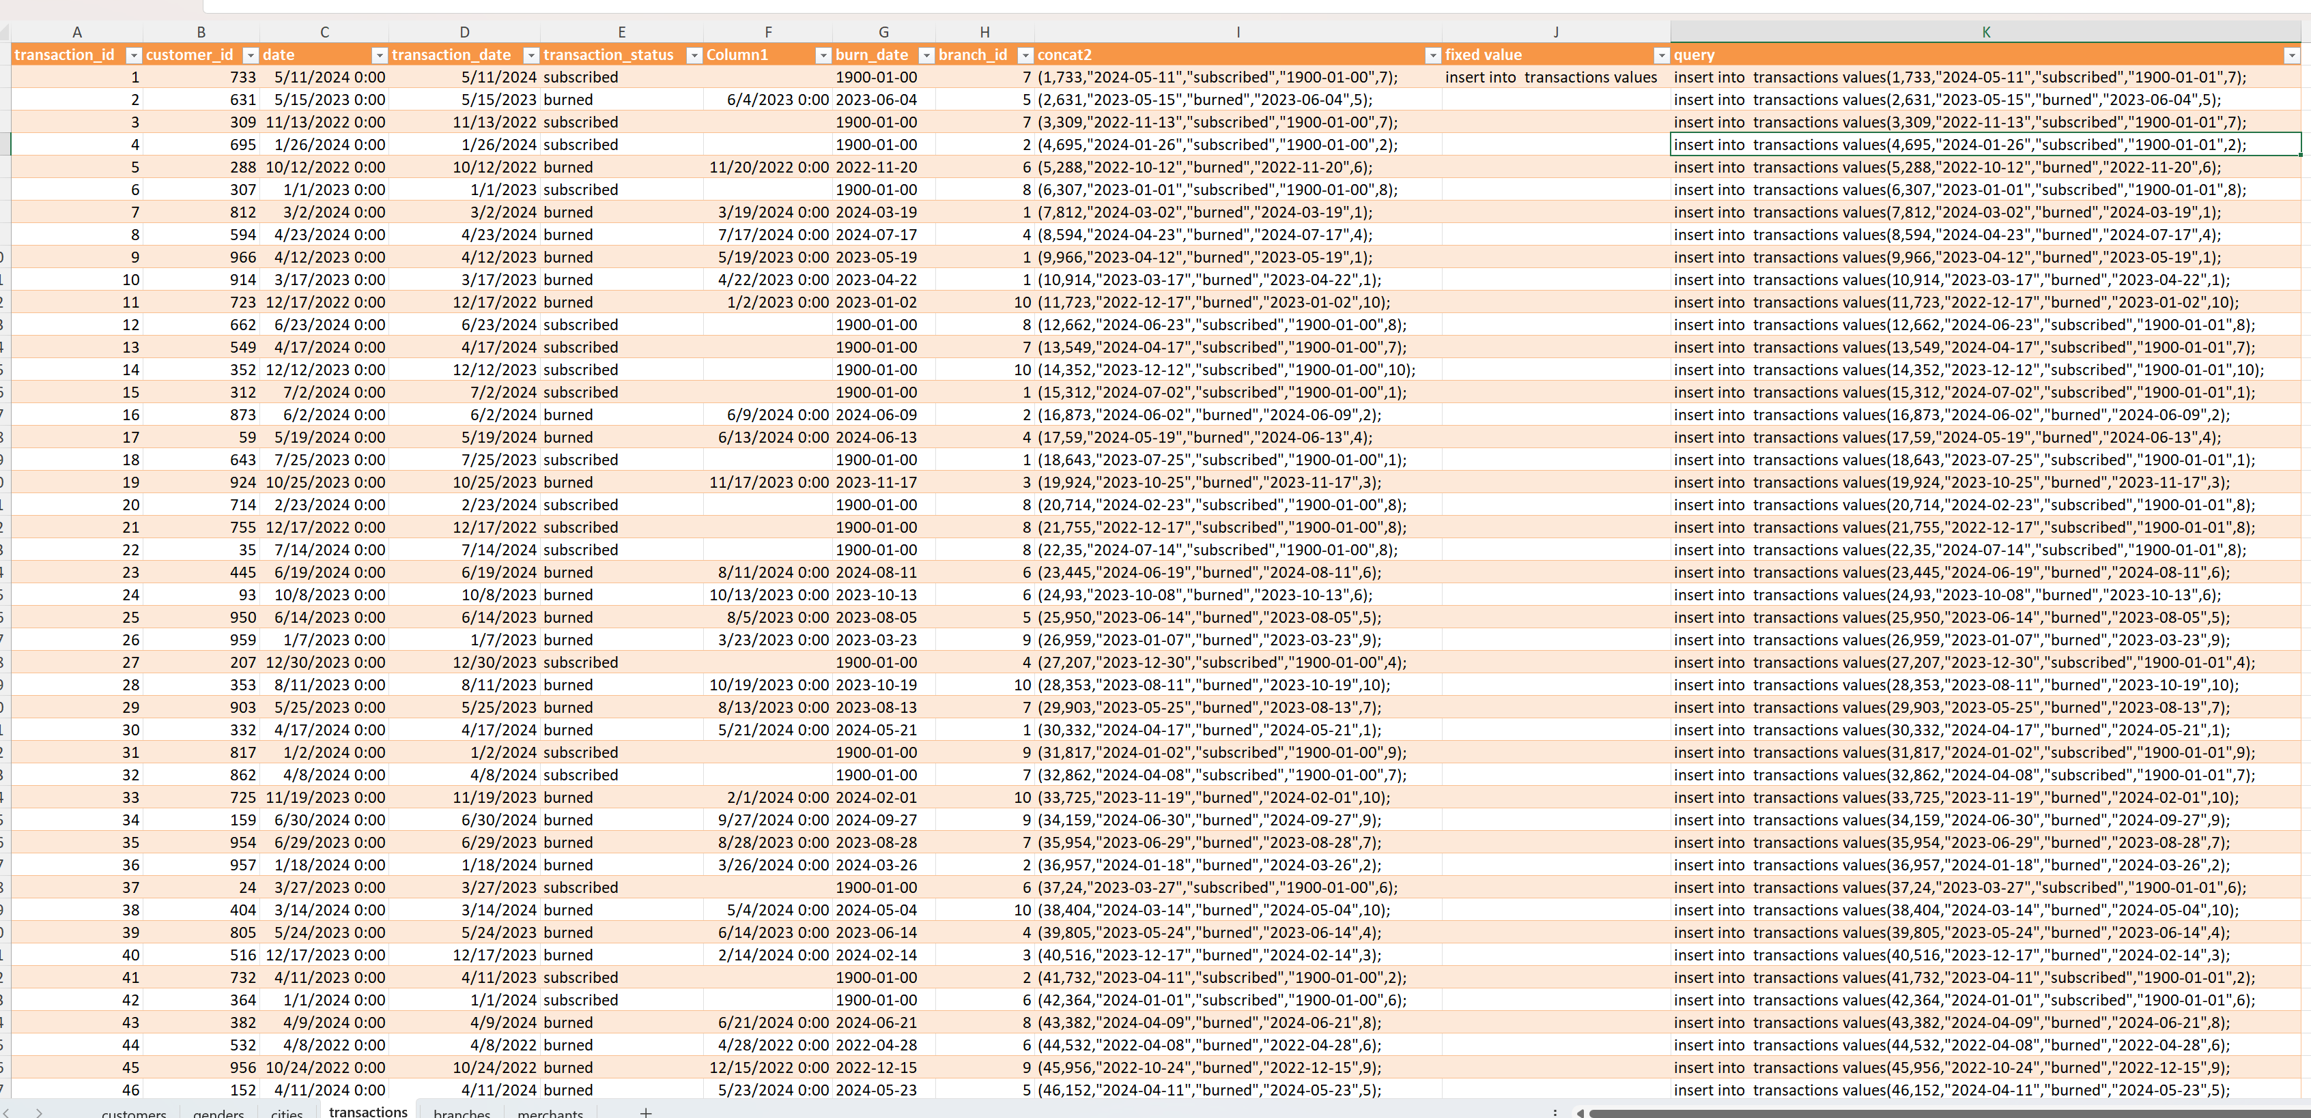
Data handling
We used EXCEL to repeat the queries like the following sample

Slide 11
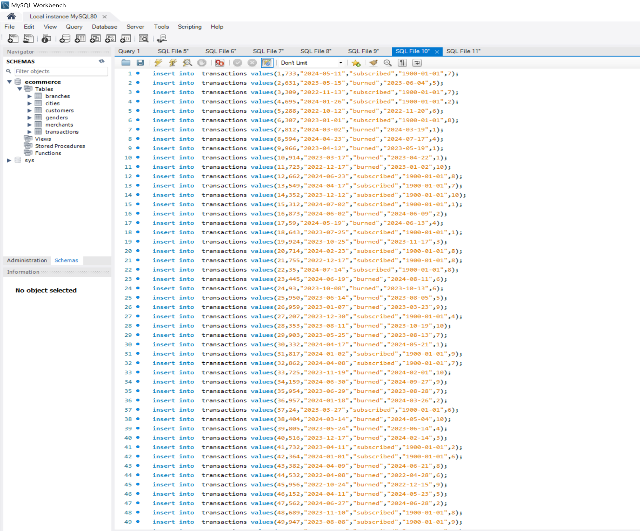
Insert data into tables SQL sample

Slide 12
Analysis of Trends Using Python
After importing libraries from python such as pandas, numpy, matplotlib.pyplot and seaborn:
Importing data from csv file
Showing data head and tail
Showing data information and description
Data cleaning
Data shape and size
Data cloumns and df
Some data counts
Data sorting
The Insights were as presented in the next couple of slides

Slide 13
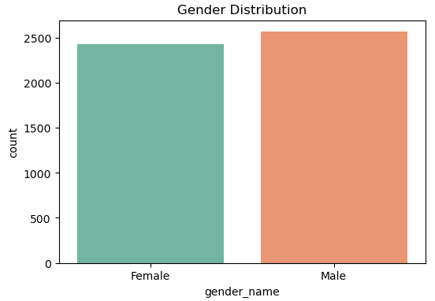
Trend Analysis
Distribution of Gender
Conclusion Across Months
The gender distribution of our e-commerce customer base is almost evenly split between male and female.
Implication: Our marketing and product strategies should target both genders equally.
Next Step: Perform a deeper analysis to understand gender-specific purchasing behavior and optimize campaigns accordingly.

Slide 14
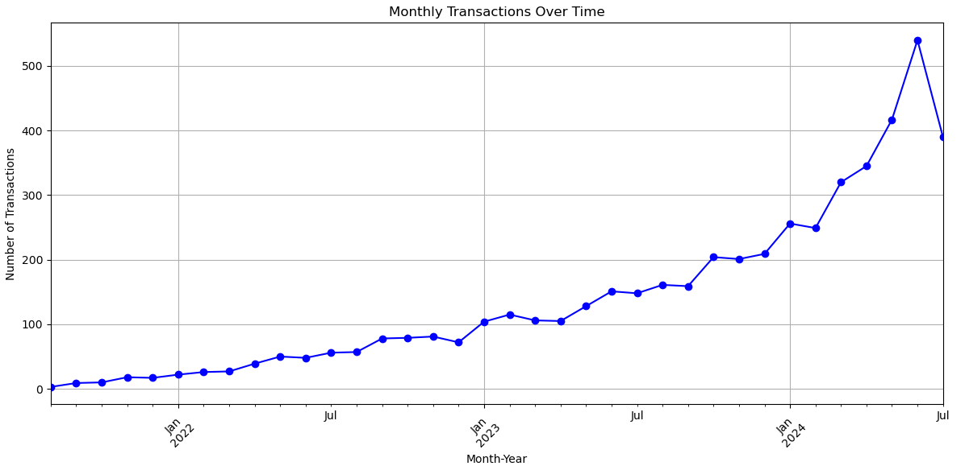
Trend Analysis
Transactions Across Months
Conclusion Across Months
The number of monthly transactions has shown significant growth from early 2022 to mid-2024.
There is a clear upward trend, with notable spikes in transaction activity in early 2024.
Implication: The growth indicates increased customer engagement and demand. Investigate reasons for the recent spike and explore sustaining this momentum moving forward.

Slide 15
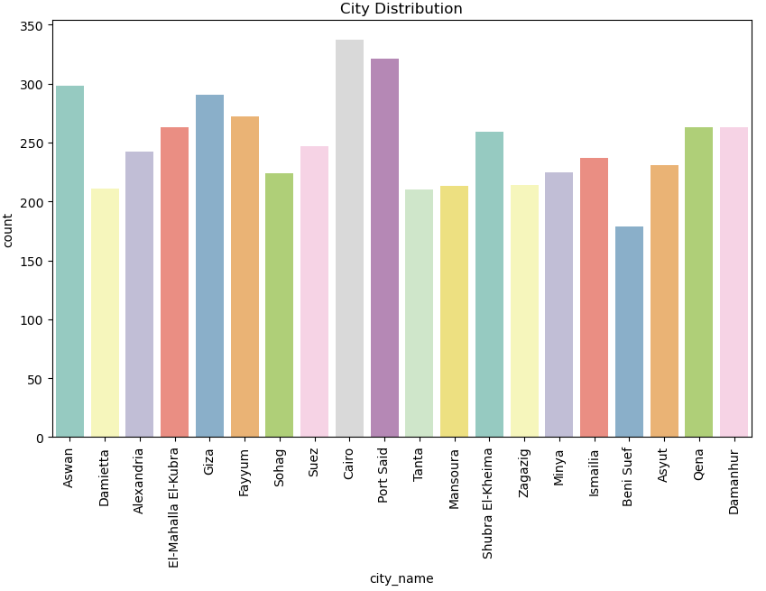
Trend Analysis
The chart indicates that cities like Cairo, Port Said, and Aswan have the highest data counts, suggesting significant engagement or activity in these areas.
In contrast, cities such as Beni Suef show lower counts, highlighting potential opportunities for increased focus or outreach. This distribution provides valuable insights for prioritizing efforts based on regional performance
Distribution of Cities
Conclusion of Cities

Slide 16
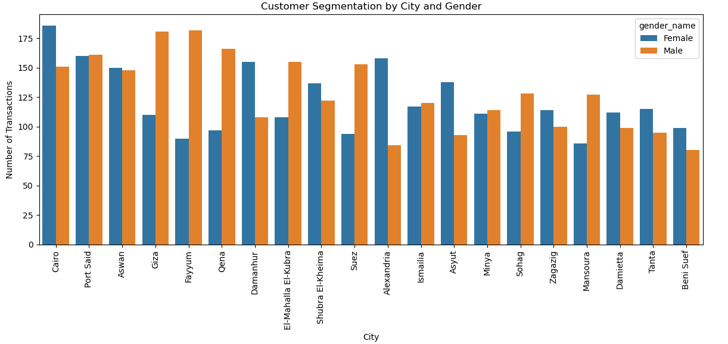
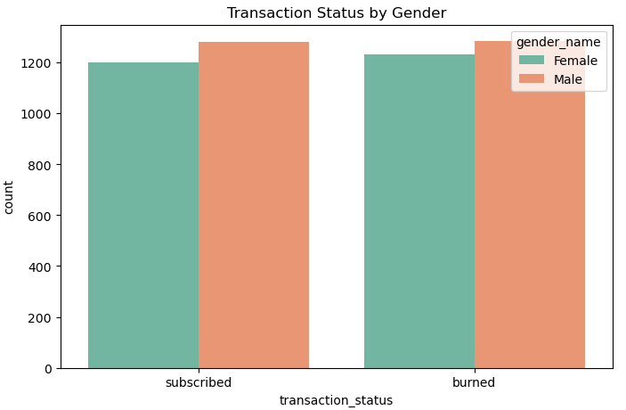
Trend Analysis
Customer Segmentation by City and Gender
The Relationship Between Gender and Transaction Status

Slide 17
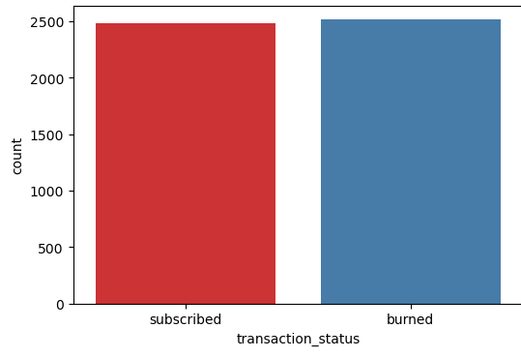
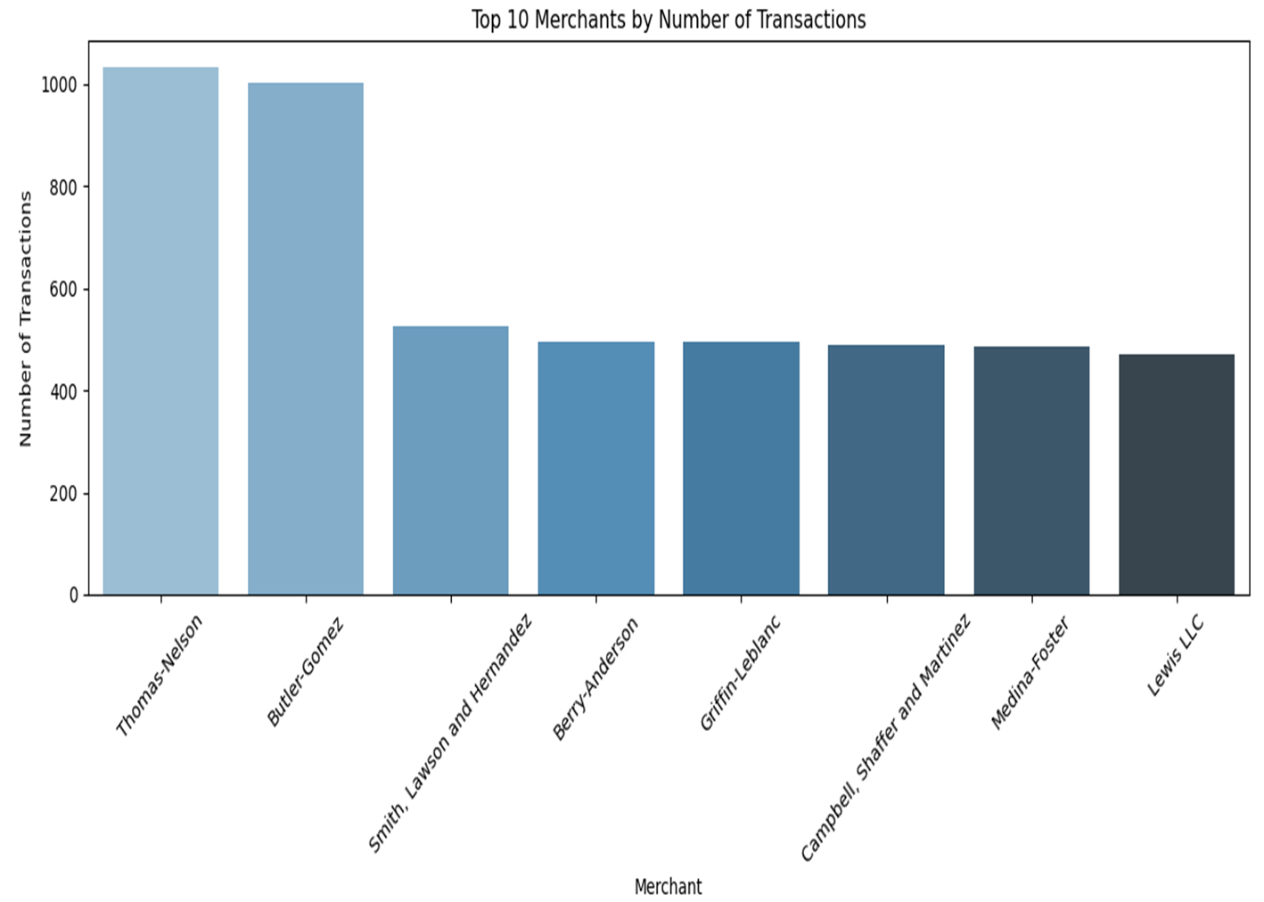
Trend Analysis
The Relationship Between Gender and Transaction Status
Transaction Status Distribution

Slide 18
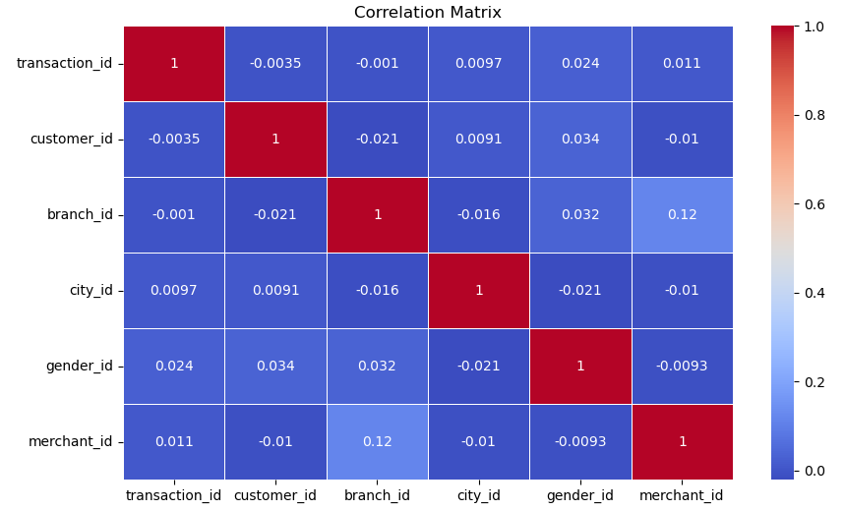
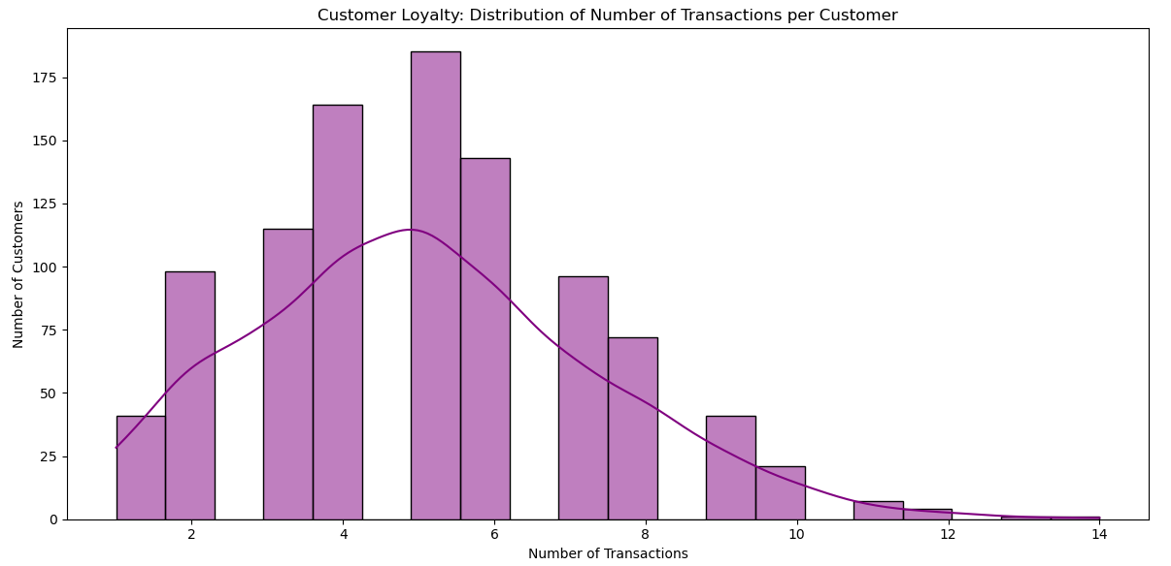
Trend Analysis
Analyzing The Correlation Between Numerical Features
Customer Loyalty Analysis

Slide 19
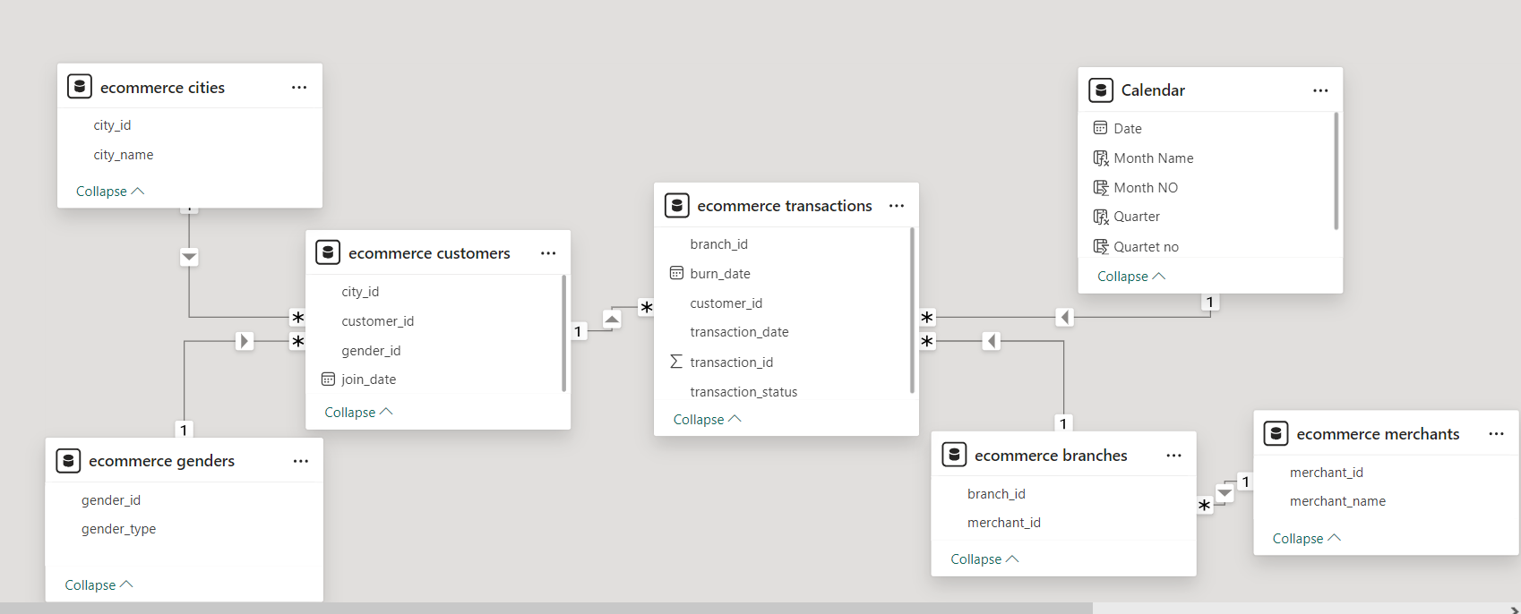
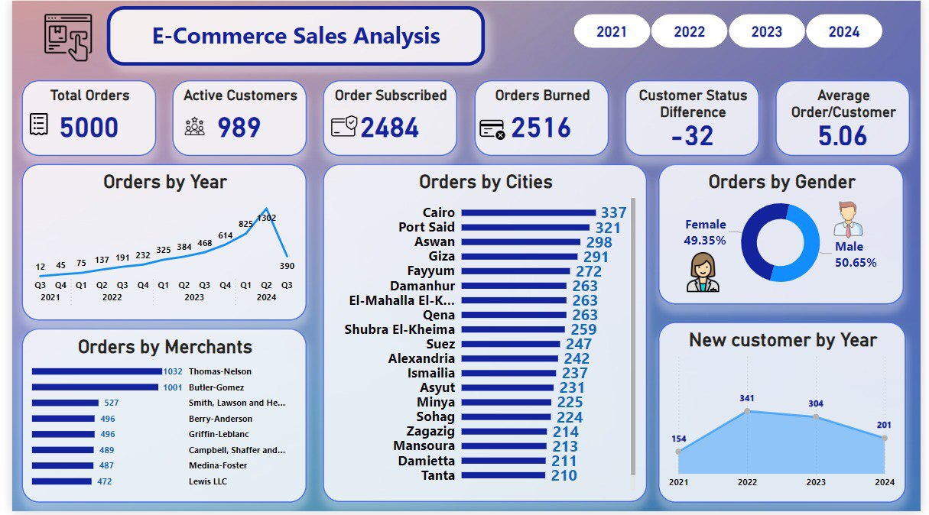
E-commerce analysis using power bi
Building Visualizations
Import Data into Power BI from SQL
Clean and Transform the Data
Create a calendar table to facilitate accurate and flexible time-based analysis
Create Relationships
Create Measures Using DAX
KPIs (Key Performance Indicators)
Line Chart:
Bar Chart
Pie Chart
Line Chart
Year Slicer
Build Visualizations

Slide 20
Recommendations
Based on the insights from the dashboard you provided, here are some tailored recommendations to improve your e-commerce performance:
Customer Retention & Engagement Active Customers vs. Orders Burned: You have 2,516 orders burned, which indicates potential issues with order fulfillment or customer churn. Focus on: Enhanced customer support to resolve issues quickly . Re-engagement campaigns through emails, SMS, or social media to win back lost customers . Customer feedback surveys to understand why customers stop purchasing and how to improve.
Optimizing Average Order Value (AOV)Average Order/Customer (5.06): To raise this:Upselling and Cross-selling: Use product bundles, recommended products, and limited-time offers during checkout.Free Shipping Thresholds: Encourage larger orders by offering free shipping for purchases above a certain amount. Discounts on Bulk Purchases: Implement volume-based discounts for customers who buy more.

Slide 21
Recommendations
Target High-Performance Cities Orders by Cities: Cairo, Port Said, and Aswan are your top-performing cities. You can: Localized marketing efforts: Run targeted ads, promotions, or events specifically for top-performing cities. Improve shipping and fulfillment services in these cities to strengthen customer loyalty . Expand operations into nearby areas of high-performing cities to capture potential customers.
Boost Underperforming Regions Cities like Mansoura, Damietta, and Tanta have lower order numbers. Consider : Localized promotions and offers in these cities to boost sales . Partnerships with local influencers or businesses to increase brand visibility . Tailored campaigns for these regions, focusing on their specific needs or preferences
Customer Gender Insights Orders by Gender: There’s a nearly equal split between male (50.65%) and female (49.35%) customers. This presents an opportunity to : Personalize campaigns targeting both genders, such as product recommendations based on gender-specific preferences . Gender-specific promotions like women’s fashion sales or tech gadgets for men to cater to different segments.

Slide 22
Recommendations
Monitor Yearly Performance Orders by Year: Analyze seasonal trends and identify if it’s a temporary seasonal decline . Boost marketing efforts during low-performance quarters, especially with limited-time offers and holiday campaigns. Leverage data to predict upcoming low points and counteract with stronger campaigns and promotions.
New Customer Acquisition: Run acquisition-focused marketing campaigns on social media, Google ads, or influencer partnerships . Referral programs where existing customers are rewarded for bringing in new customers . Improve SEO to ensure your e-commerce site ranks higher in search results.

Slide 23

Thank you very much!

